Slide 1


Salpingectomy at Time of Cesarean Section without Suturing or Power Device
- A Novel Technique
Authors: Kelly Ware MS1, Alexa King MS1, Katelyn Sainz MS4, Greg Marchand MD

Slide 2

Greetings from Sunny Arizona, USA!

Slide 3

Introduction
Marchand OBGYN, PLLC – Our approach to surgery is a little different.
We are passionate about minimally invasive surgery!

Slide 4
Why did we stop “tying tubes” anyway?
Committee Opinion #620
  American College of Obstetrics and Gynecology
Necessitates salpingectomy at time of sterilization unless otherwise contraindicated.
  Adhesive disease, insufficient exposure, etc.
Excellent sterilization rates (1:10,000 failure) with decreased lifetime risk of ovarian cancer.

Slide 5
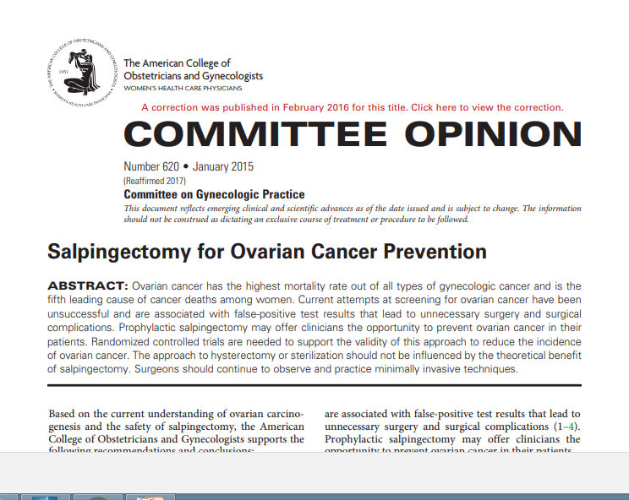

Slide 6
What does this mean for sterilization?
Laparoscopic salpingectomy instead of laparoscopic tubal ligation is new Standard of Care in USA.
Must perform bilateral salpingectomy with any hysterectomy unless contraindicated.
Must perform salpingectomy with a risk reducing bilateral oophorectomy (RRBSO) for BRCA or Lynch Syndrome

Slide 7
Sterilization at Time of Cesarean Section
Reasons NOT to take the tubes:
The blood supply to the pelvis is greater at time of pregnancy.
Limited access to preferred tools for salpingectomy.
  No Ligasure, Harmonic, ThunderBeat, etc...
Incidental cesarean hysterectomy is not preferred.
Other patients in labor or additional surgeries scheduled soon.

Slide 8
Sterilization at Time of Cesarean Section
Reasons to perform the salpingectomy:
It's the right thing to do for my patient, who is sure she doesn't want any more children, to both give her the permanent sterilization she wants and the lifetime reduced risk of ovarian cancer she deserves.

Slide 9
Idea #1 at Super Fancy Hospital
Let's just use the super expensive bipolar coagulation device to quickly remove the tubes and move onto the next case!
Advantages – Quick technique, minimal blood loss, complete removal of the fallopian tubes, no concern of disruption of the dissection site upon returning the uterus to the abdomen after C-Section.

Slide 10
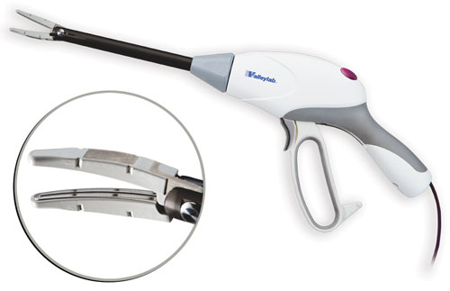
Ligaure Impact–Approx $399

Slide 11
Hospital Utilization Review
Not approved by utilization committee:
  Not reimbursed by government plans
  Inconsistent reimbursement by private plans
Acceptable for severe circumstances, but not reasonable for routine cesarean delivery with sterilization.

Slide 12
Necessity is the Mother of Invention
This new technique was conceptualized with speed and minimal blood loss of a power ligation/division device in mind when the hospital refuses to purchase, or cannot afford, a power device.
Need to give our patients the level of care they deserve for a decreased lifetime risk of ovarian cancer and permanent sterilization.

Slide 13
What Do We Have Available?
Standard Cesarean Section Open Surgical Tray
Bovie Cautery Device
Standard Scalpels
Suction and Irrigation
Drapes

Slide 14
Our Novel Technique
The goal is to mimic a Bipolar Power Ligation Division Device by using a hemostat clamp.
Electrify the clamp to 50 Watts of cutting current using the Bovie Cautery Device.
Begin the dissection at the origin of the fallopian tube at the uterus and continue dissection all the way to the fibria.

Slide 15
Our Novel Technique
Continue electrifying the hemostat until the tissue “pops” and sizzles, or until a clear area of blanching is seen in the broad ligament consistent with coagulation of the vascular supply in that area.
Take large bites through translucent areas of the broad ligament where there are no visible blood vessels, perhaps the whole length of the hemostat jaws.

Slide 16
Our Novel Technique
Take tiny bites through any visible vessels or through the actual base of the fallopian tubes at the uterus.
Keep dissection snug against the actual fallopian tube, avoid any vasculature in the broad ligament that does not absolutely have to be divided to remove the tube.

Slide 17
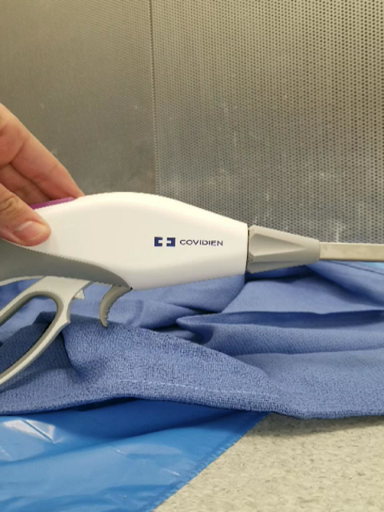
https://youtu.be/RZnESRBwat0

Slide 18
Since Adapting this Technique in November 2017
5 procedures have been completed successfully.
No additional blood loss reported.
Additional operative time is estimated at 3.5 minutes by the surgeon and assist.
No conversions to cesarean hysterectomy thus far.

Slide 19
Conclusions Thus Far
Seems to be an efficient technique for salpingectomy at time of cesarean section.
Seems to have no additional equipment costs for hospital, ideal for cost saving environments.
Seems to have no significant effect on operative time.
Seems to convey benefits of more techniques with more expensive equipment.

Slide 20
Thank You EBCOG 2018!
It is a pleasure to visit this beautiful city
and be a part of this conference!

Slide 21
Thank you for your attention

